Slide 1
Intro to Mapping
Giovanni Pietro Vitali
giovannipietrovitali@gmail.com

Slide 2



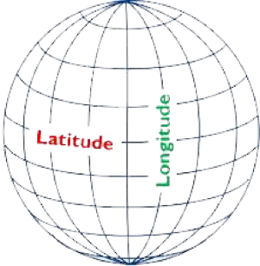

Representing geographical
information
Through coordinates
For managing complex contents.

Slide 3
What should a digital cartographer do?
Collection and prior analysis of documents
Data collection
MAPPING
CORPUS
DATASET
MAP

Slide 4
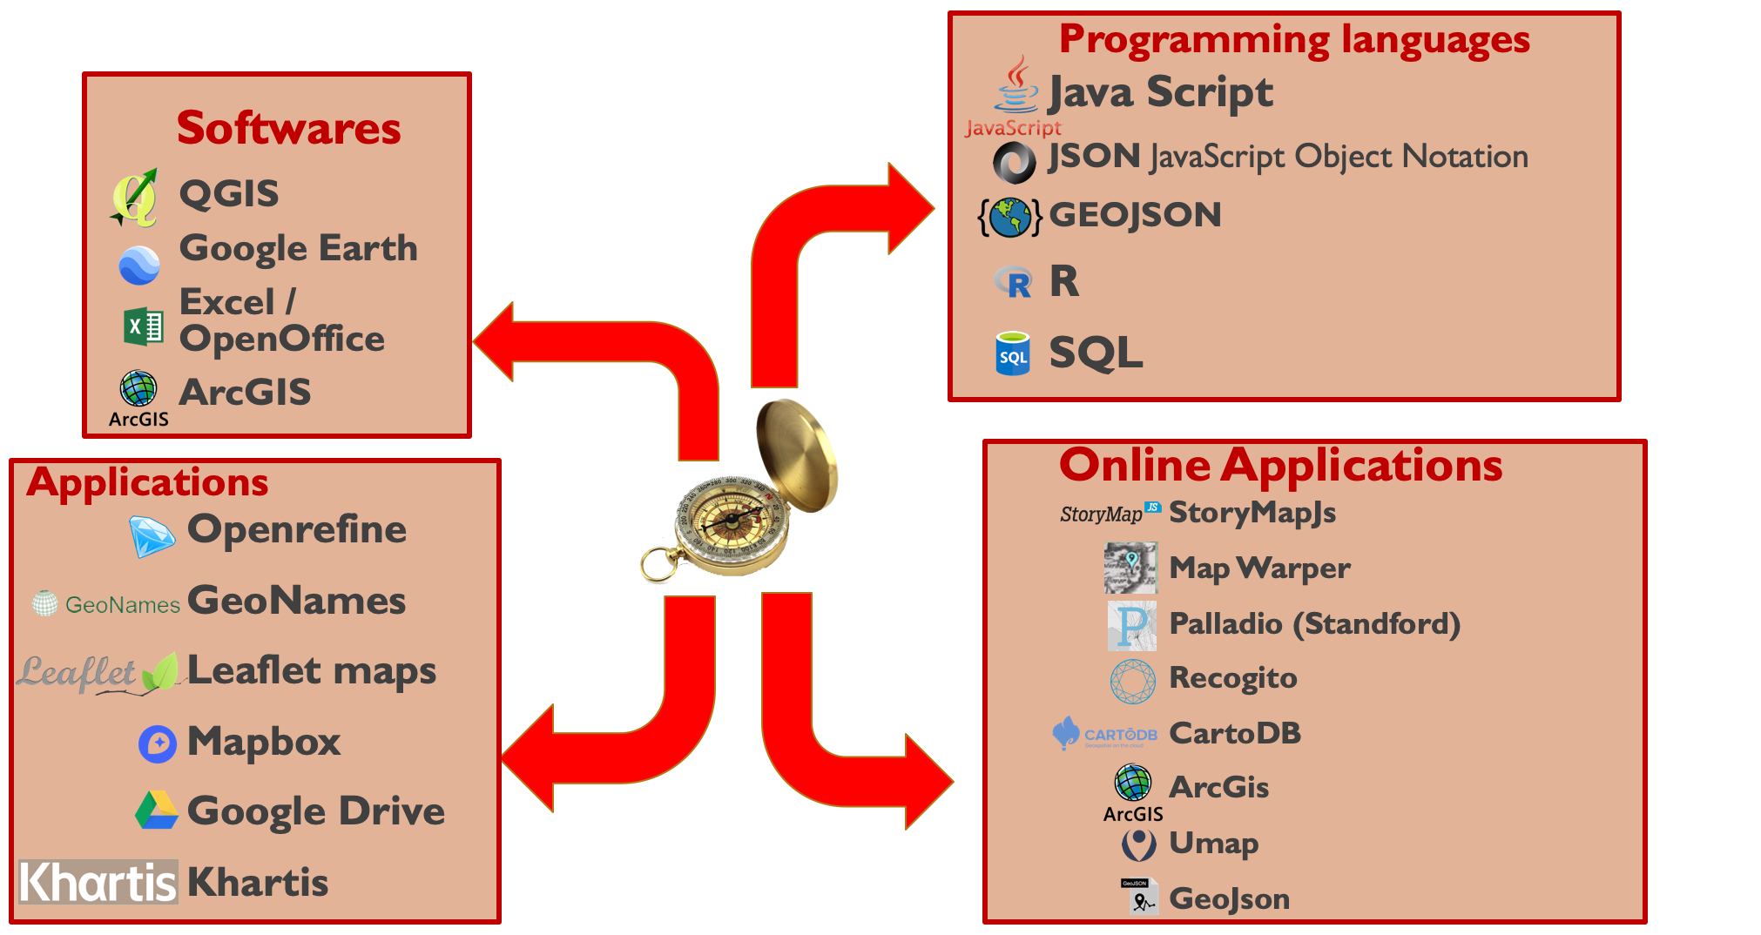

Slide 5
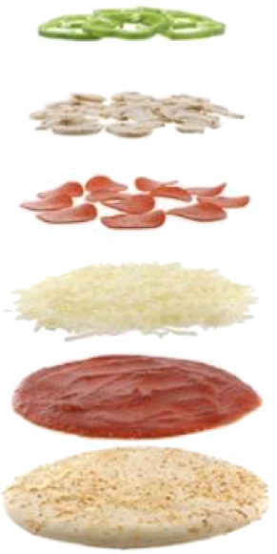
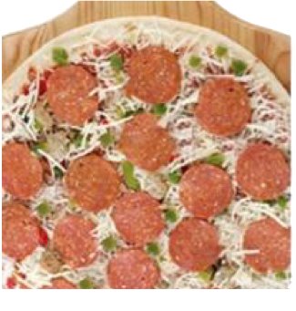
THE LAYER
A key concept in GIS
(Geographic Information System)

Slide 6
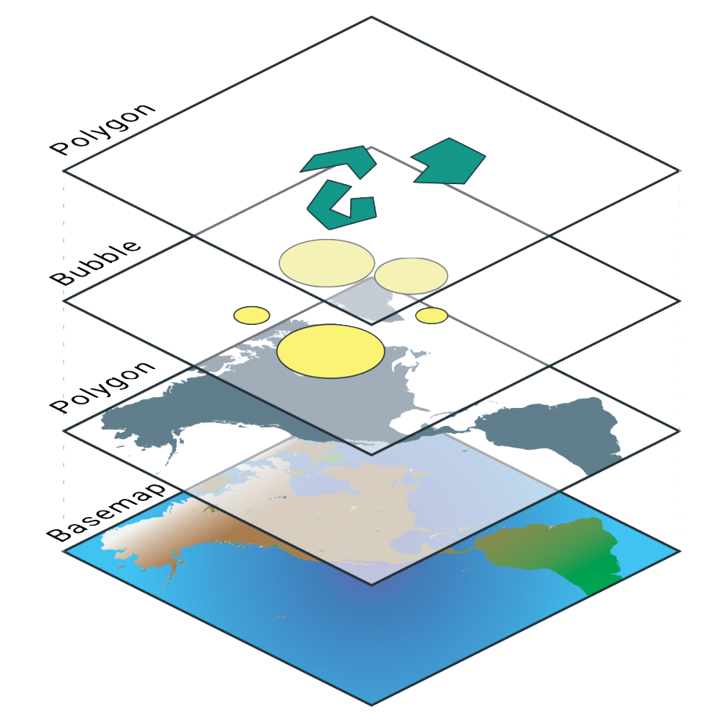
Layers

Slide 7
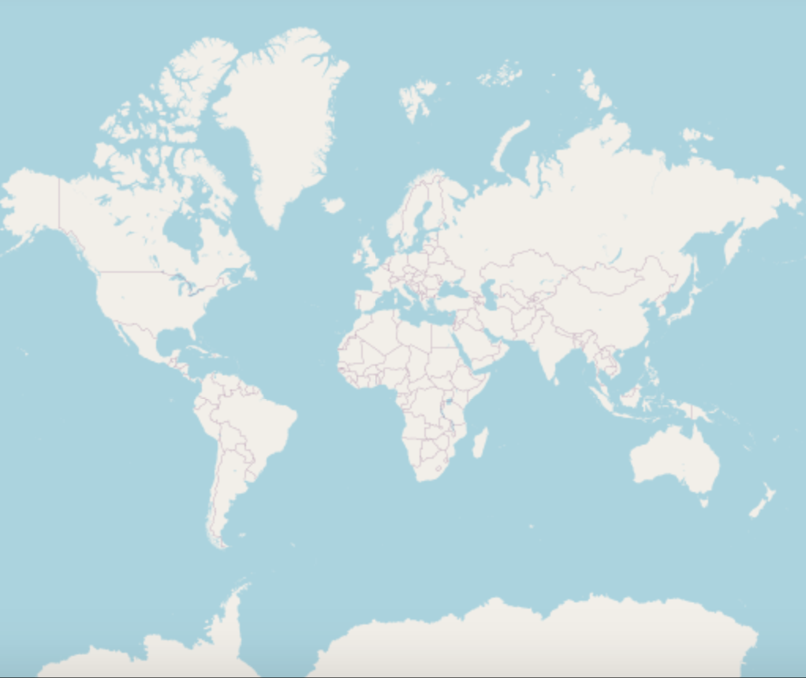
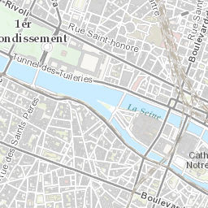
BASEMAP
http://leaflet-extras.github.io/leaflet-providers/preview/index.html

Slide 8

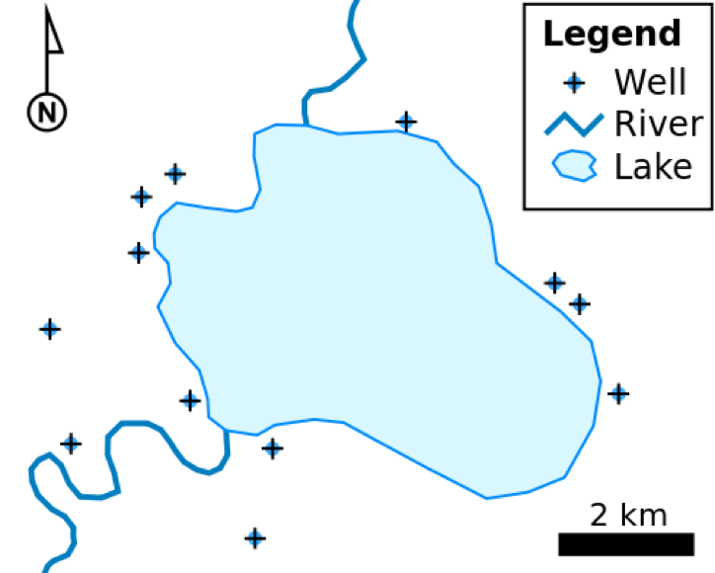
Points
Zero-dimensional points are used for geographical features that can best be expressed by a single point reference.
Lines or polylines
One-dimensional lines or polylines are used for linear features such as rivers, roads, railroads, trails, and topographic lines.
Polygons
Two-dimensional polygons are used for geographical features that cover a particular area of the earth's surface.

Slide 9
•AutoCAD DXF – contour elevation plots in AutoCAD DXF format (by Autodesk)
•Cartesian coordinate system (XYZ) – simple point cloud
•Digital line graph (DLG) – a USGS format for vector data
•Esri TIN - proprietary binary format for triangulated irregular network data usedby Esri
•Geography Markup Language (GML) – XML based open standard (by OpenGIS) for GIS data exchange
•GeoJSON – a lightweight format based on JSON, used by many open source GIS packages
•GeoMedia – Intergraph's Microsoft Access based format for spatial vector storage
•ISFC – Intergraph's MicroStation based CAD solution attaching vector elements to a relational Microsoft Access database
•Keyhole Markup Language (KML) – XML based open standard (by OpenGIS) for GIS data exchange
•MapInfo TAB format – MapInfo's vector data format using TAB, DAT, ID and MAP files
•Measure Map Pro format – XML data format to store GIS data
•National Transfer Format (NTF) – National Transfer Format (mostly used by the UK Ordnance Survey)
•Spatialite – is a spatial extension to SQLite, providing vector geodatabasefunctionality. It is similar to PostGIS, Oracle Spatial, and SQL Server with spatialextensions
•Shapefile – a popular vector data GIS format, developed by Esri
•Simple Features – Open Geospatial Consortium specification for vector data
•SOSI – a spatial data format used for all public exchange of spatial data in Norway
•Spatial Data File – Autodesk's high-performance geodatabase format, native to MapGuide
•TIGER – Topologically Integrated Geographic Encoding and Referencing
•Vector Product Format (VPF) – National Geospatial-Intelligence Agency (NGA)'sformat of vectored data for large geographic databases

Slide 10



GeoJSON – a lightweight format based on JSON, used by many open source GIS packages
Keyhole Markup Language (KML) – XML based open standard (by OpenGIS) for GIS data exchange
Shapefile – a popular vector data GIS format, developed by Esri

Slide 11

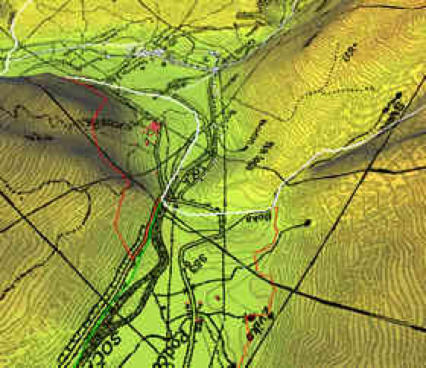
Esri grid – proprietary binary and metadataless ASCII raster formats used by Esri
GeoTIFF – TIFF variant enriched with GIS relevant metadata
IMG – ERDAS IMAGINE image file format
JPEG2000 – Open-source raster format. A compressed format, allows both lossyand lossless compression.
MrSID – Multi-Resolution Seamless Image Database (by Lizardtech). A compressed wavelet format, allows both lossy and lossless compression.
GeoTIFF – TIFF variant enriched with GIS relevant metadata
Distant Reading in

Slide 12





Microsoft Excel
OpenOffice spreadsheet
OpenRefine
Plan texts softwares

Slide 13

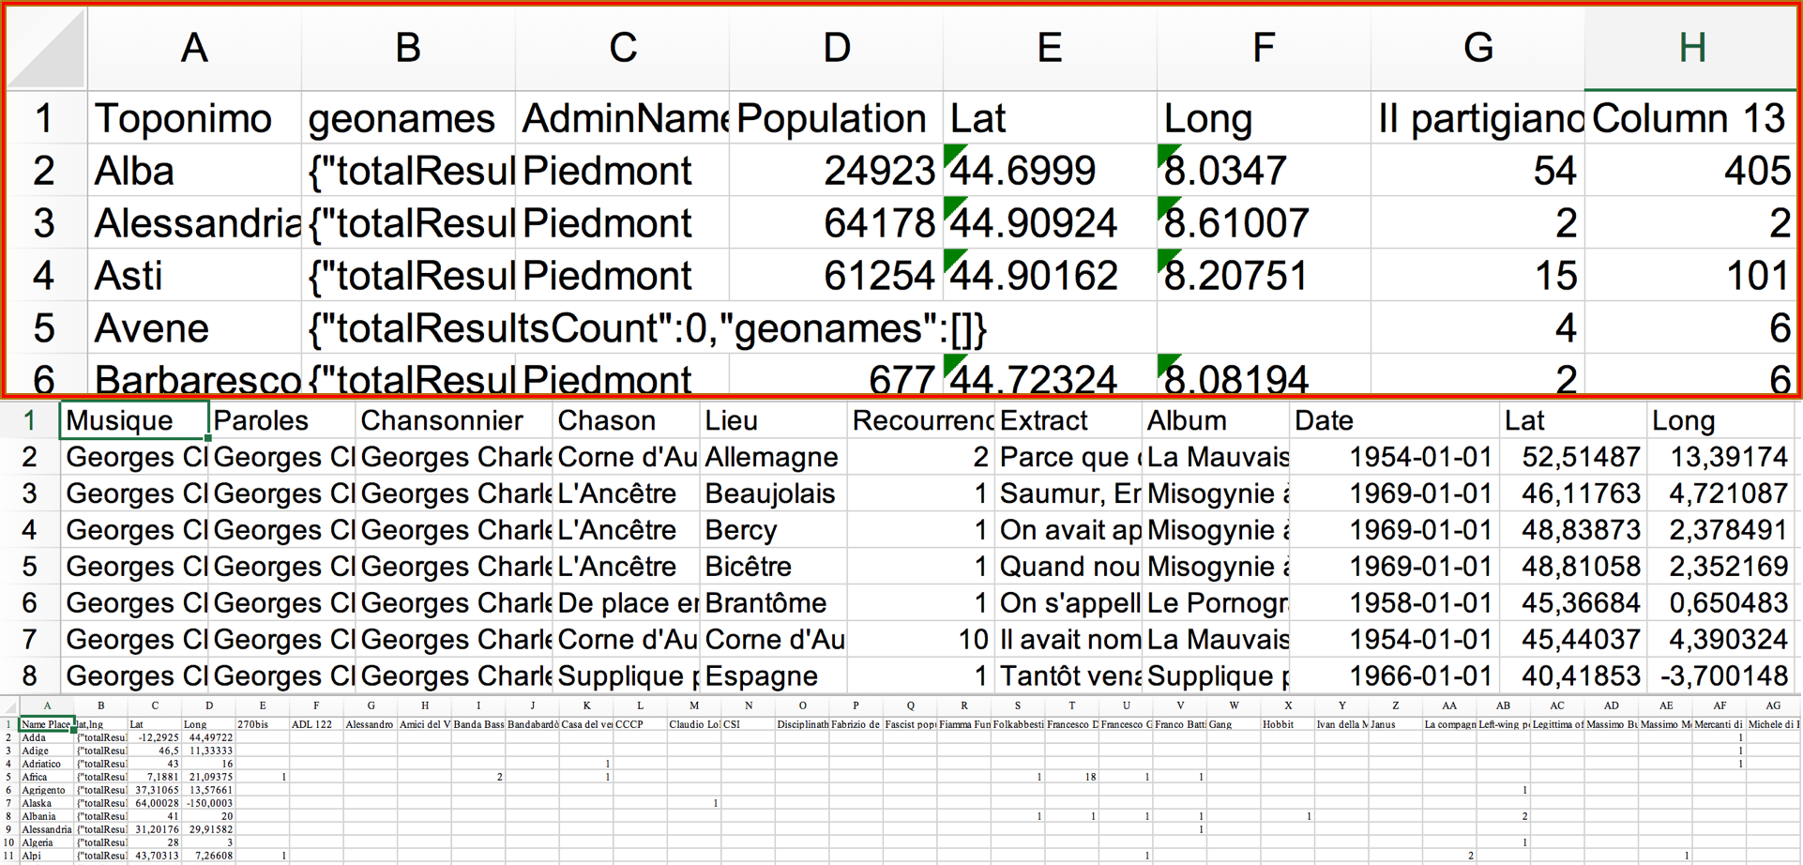



Slide 14

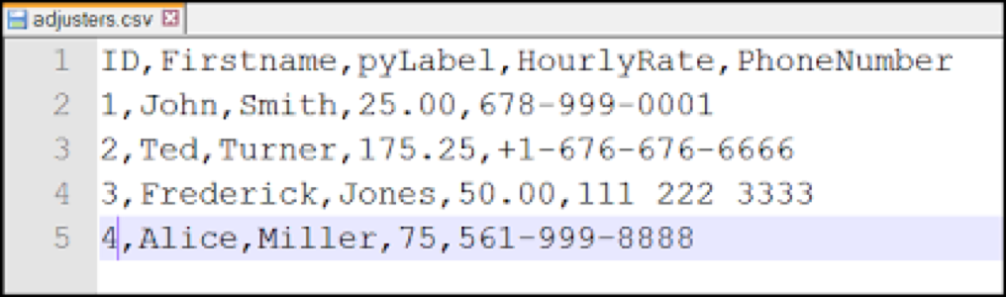

Slide 15

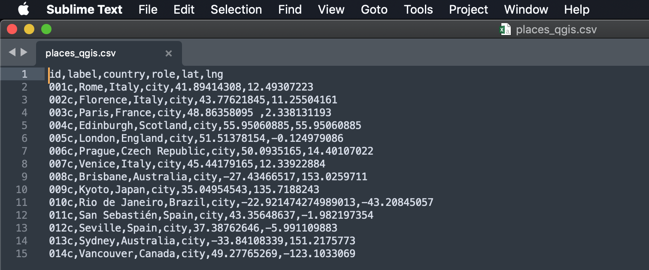
CSV – A comma-separated values (CSV) file is a delimited text file that uses a comma to separate values. Each line of the file is a data record. Each record consists of one or more fields, separated by commas.
Distant Reading in

Slide 16
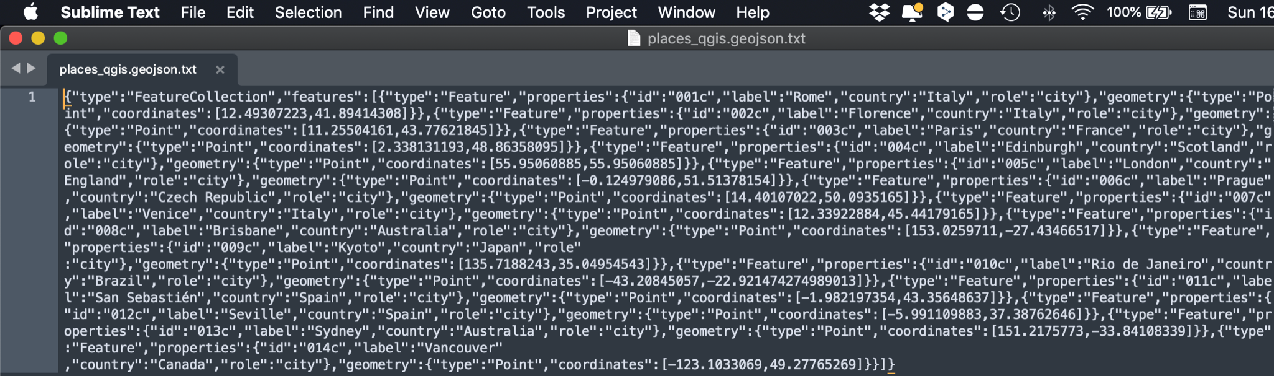
GeoJSON – a lightweight format based on JSON, used by many open source GIS packages

Slide 17
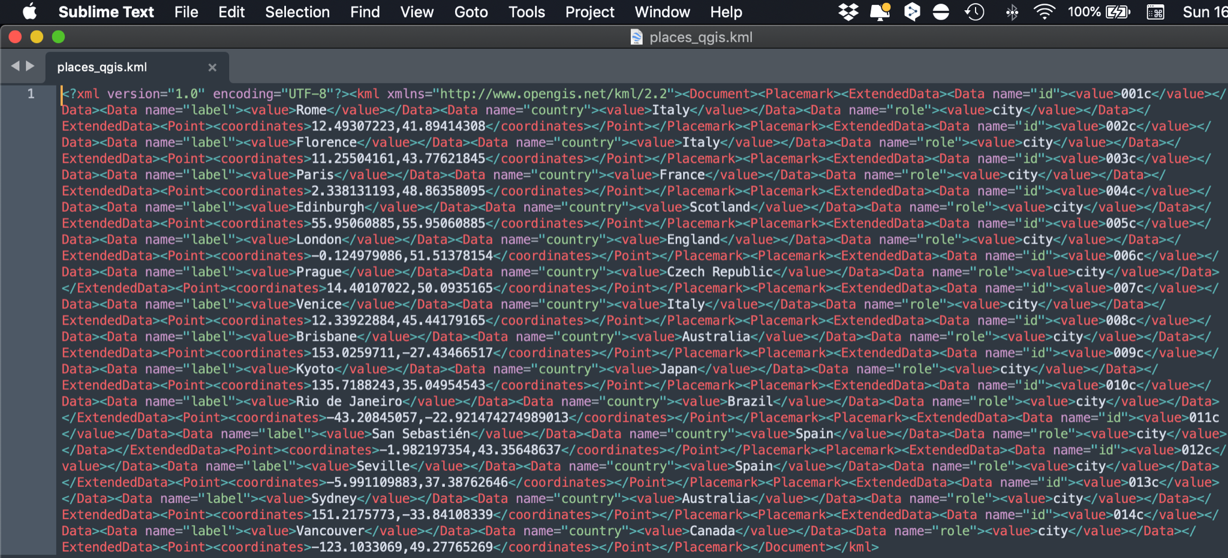
Keyhole Markup Language (KML) – XML based open standard (by OpenGIS) for GIS data exchange

Slide 18
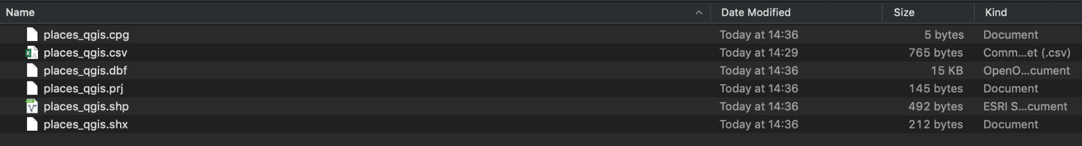
Shapefile – a popular vector data GIS format, developed by Esri

Slide 19
Examples:
Atlas Nazi-Fascist Repression
Github: https://bit.ly/atlas_repression_github
Article: https://bit.ly/atlas_article
Map: https://bit.ly/atlas_repression
French Theatre 17th century
Github: https://bit.ly/french_theatre_17_github
Artile: https://bit.ly/theatre_of_places
Map: https://bit.ly/french_theatre_17
Token mapbox: pk.eyJ1Ijoia29pbmU4MiIsImEiOiJjbGdmNXJ1aGEwY2JkM3NtdnhzdnNub3VuIn0.j1UBu01cmvGR5XU3RLXZAA
Data:
GADM: https://gadm.org
Data editor (Geojson): https://geojson.io/
GeoFile Data Converter: https://mygeodata.cloud
Data: https://bit.ly/pizza_map

Slide 20
Intro to Mapping
Giovanni Pietro Vitali
giovannipietrovitali@gmail.com

